Slide 1

SignoSpeak: Bridging the Gap
Conversion of Sign Language to Text
For Deaf and Mute
-CrackHead Tetralogy

Slide 2
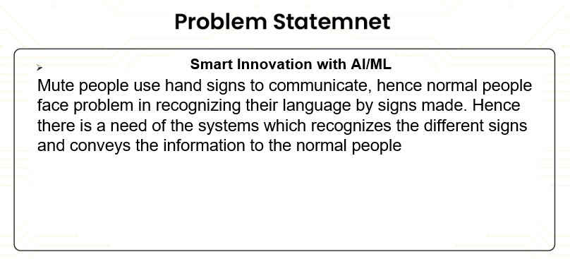

Slide 3
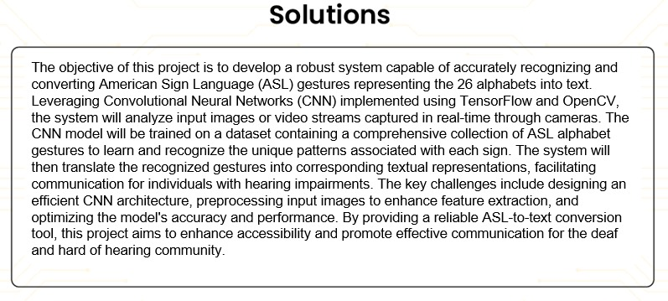

Slide 4
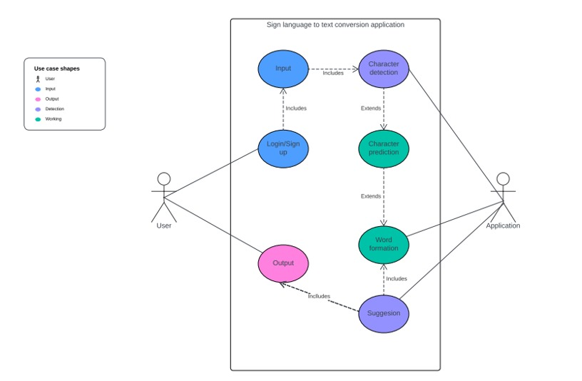
UML DIAGRAM

Slide 5
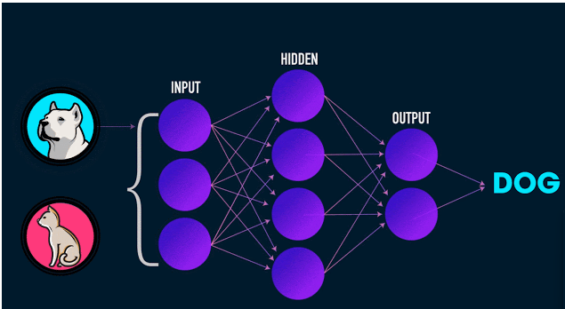
CNN WORKFLOW

Slide 6
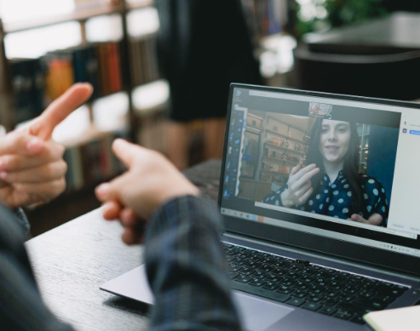
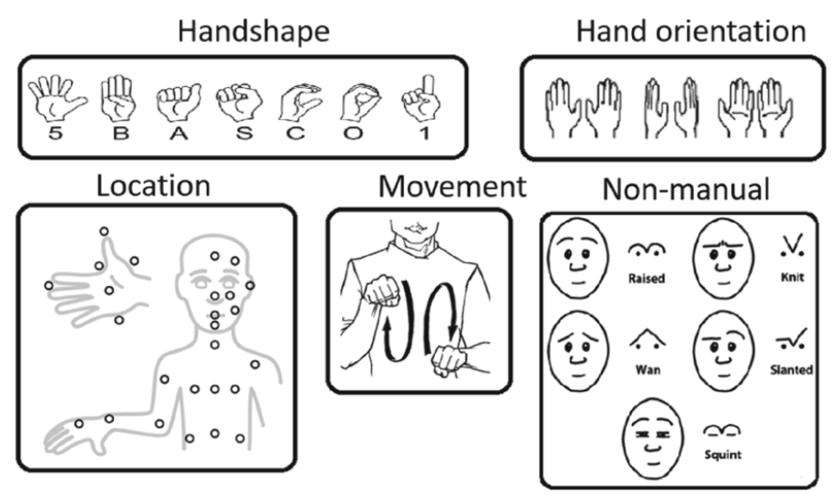
Basic Components of Sign Language include:

Slide 7
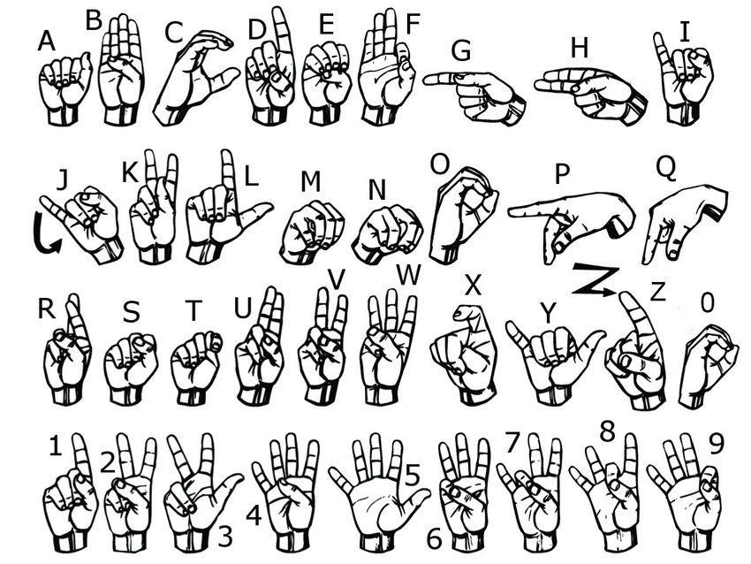
ASL (American Sign Language)
American Sign Language (ASL) is foundational among global sign languages, influencing many others.
In the US, it's crucial, with over half a million speakers.
Its broad usage highlights the need for sign language accessibility and understanding, fostering inclusivity and communication equality.

Slide 8
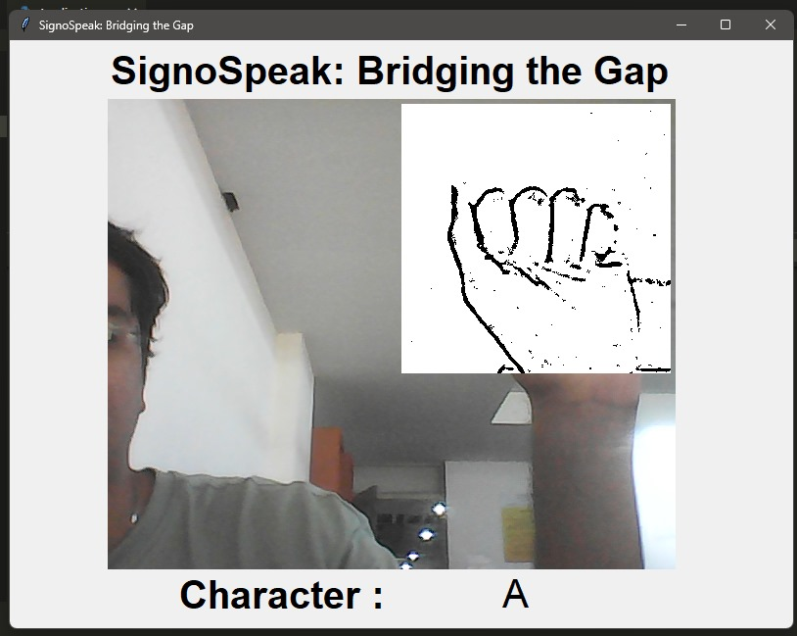
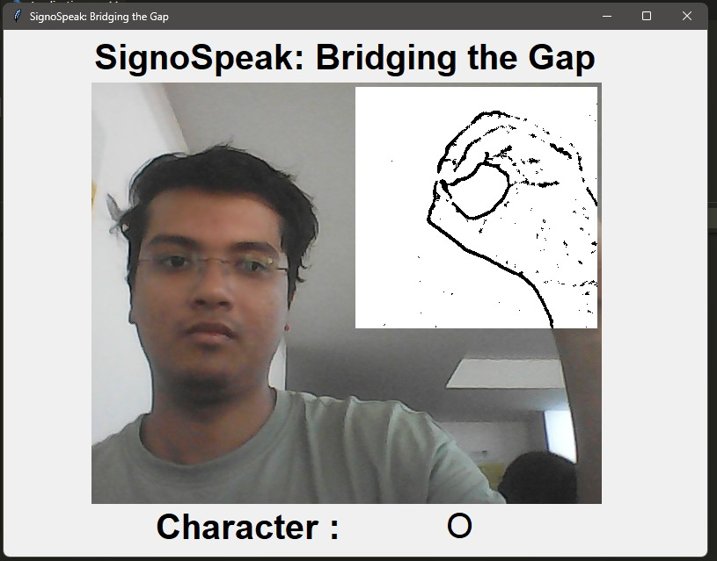
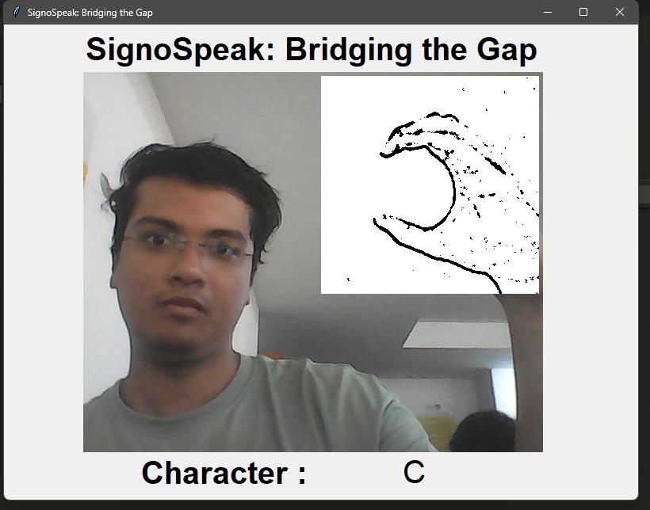
Capturing Raw Data

Slide 9
Where it can be used ?
Education: In educational settings, sign-to-text conversion technology can assist deaf or hard of hearing students by providing real-time captions during lectures, presentations, and classroom discussions. This helps ensure they have equal access to educational content.
Video Content Accessibility: For online videos or video conferencing platforms, sign-to-text conversion technology can automatically generate captions or subtitles from sign language present in the video, making the content accessible to a broader audience.
Human-Computer Interaction: Sign-to-text conversion can enhance interactions with computers and mobile devices, enabling users to input commands and communicate using sign language instead of traditional keyboard and mouse inputs.
Communication with Customer Support: Sign-to-text conversion can be integrated into customer support systems, allowing deaf or hard of hearing customers to communicate with support agents using sign language while receiving written responses.
Public Events and Broadcasting: Sign-to-text conversion technology can be used in live events, public announcements, and broadcasting to provide real-time sign language interpretation in the form of text overlays.

Slide 10
Future Scopes
Enhanced Accuracy.
Multilingual and Multi-model support.
Mobile and Wearable device integration.
Community engagement and feedback
Integration with smart assistant
Advanced Gesture Recognition

Slide 11
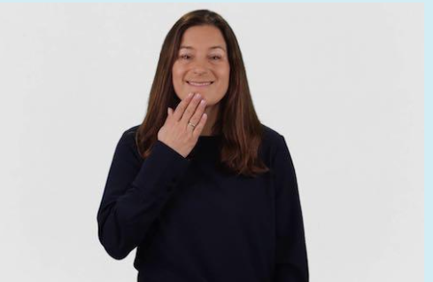
THANK YOU!

